Slide 1
HOW TO SUBMIT AND PUBLISH OPEN ACCESS UNDER AN INSTITUTIONAL AGREEMENT A GUIDE FOR AUTHORS

Slide 2
Introduction
De Gruyter has established institutional open access agreement with your institution. This arrangement enables you as affiliated researcher to publish your article open access at no cost in our entire journal portfolio, which is also fully accessible to you as a reader.
The following presentation will guide you through the submission and publication process. To ensure that you are recognized as an eligible author, it is essential that you submit your article using your institutional email address.
If you have any questions about the process or want to find out about the eligibility of your article, please contact Oafunding@degruyter.com.
Further information about the terms of our agreements and participating institutions can also be found here: https://www.degruyter.com/publishing/publications/openaccess/open-access-agreements

Slide 3
Step 1: Choose a journal
Choose the journal that best fits your work on degruyter.com. You can browse our journals here
The agreement enables open access publishing in nearly our entire journal portfolio, with the exception of a few titles, mainly journals from our publisher partners. If you are uncertain whether your selected journal is covered by the agreement, please contact Oafunding@degruyter.com
Once you have identified a journal, visit the journal’s website and review the instructions for authors

Slide 4
Step 2: Submit your article
On your chosen journal’s homepage, you can find information on how to submit your article.
Many of our journals have Editorial Manager or Scholar One as online submission management systems. A link will move you directly to the journal’s dedicated submission page.
For those journals that do not operate with a submission system, you can find information how to submit under the “submit tab”.

Slide 5
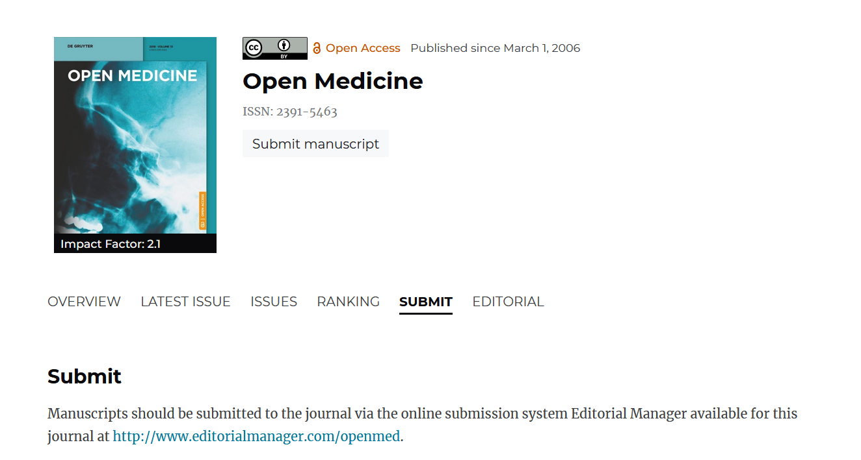
Step 2: Submit your article

Slide 6
Step 2: Submit your article
For journals with a submission system, please complete the submission form.
Please note that eligibility is determined based on the corresponding author's affiliation. Ensure that you use your institutional email address any time in the publication process.
The following slides provide detailed instructions on where to enter your institutional affiliation process in the submission process in Scholar One and Editorial Manager.

Slide 7
Step 2: Submit your article
Where to enter institutional affiliation information in Editorial Manager
Ensure that your institutional affiliation and email address are registered here.

Slide 8
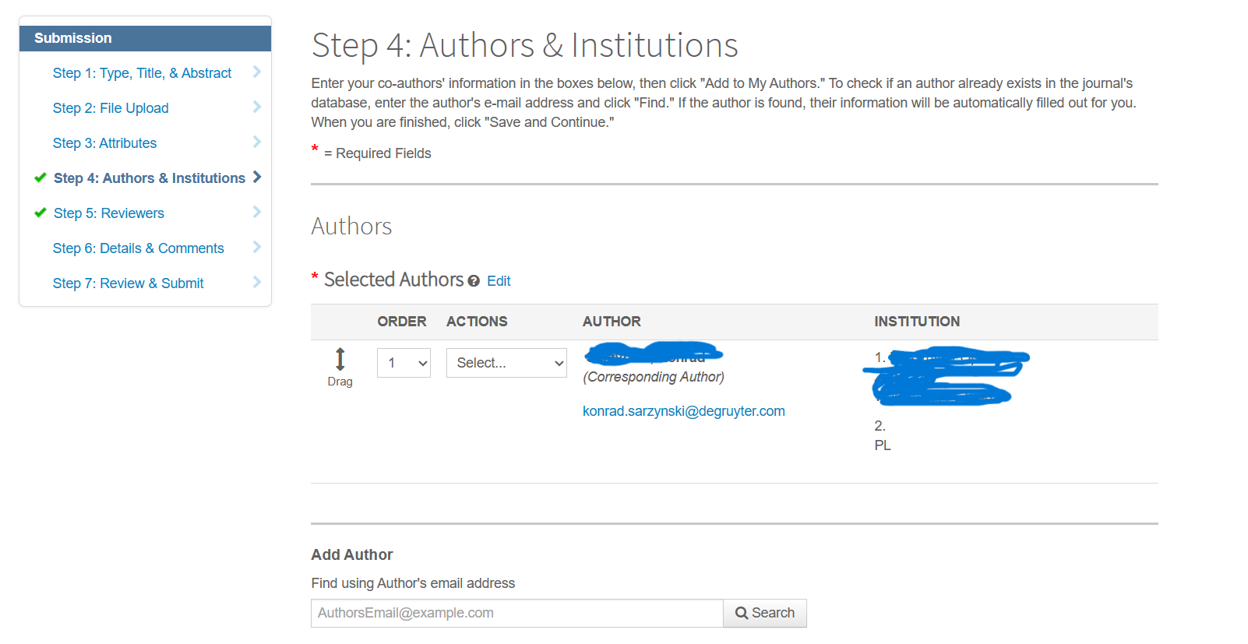
Step 2: Submit your article
Where to enter institutional affiliation information in Scholar One
Ensure that your institutional affiliation and email address are registered here.

Slide 9
Step 3: Accept our terms and conditions
During submission and after acceptance, you will be prompted to accept our terms and conditions.
We have two different publishing contracts/license to publish in place depending on whether you submit to a fully gold open access or hybrid/S2O journal.
For all open access articles, authors retain the copyright.
De Gruyter applies a CC BY 4.0 license to most of our open access articles to ensure compliance with funder mandates worldwide.

Slide 10
Step 4: After acceptance
Article processing charge automatically waived
After your article has undergone peer review and has been accepted, we automatically verify whether an open access agreement is applicable. The open access transaction process is managed by our partner, Rightslink's Open Access Agreement Manager.
Depending on the terms and conditions of the agreement and your institution, you will interact differently with our open access transaction process.
In all cases, no article processing charge will be charged. You will receive a confirmation email from our partner, Rightslink, that your OA funding has been approved.
For S2O titles, there is no interaction with RightsLink necessary. Your article will be published open access after acceptance.

Slide 11
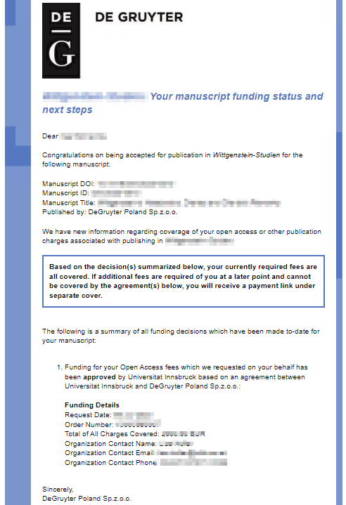
Step 4: After acceptance
Article processing charge automatically waived
Confirmation email from our partner Rightslink on our behalf, confirming the acceptance of OA funding for your article.

Slide 12
Step 5: Promote your research
After your article is published open access on degruyter.com, promote your research.
Here, you can find some recommendations and tips from us:
https://www.degruyter.com/publishing/for-authors/for-journal-authors/promoting-your-article
https://blog.degruyter.com/how-to-your-promote-your-research-article-on-social-media
https://blog.degruyter.com/how-to-blog-about-your-research/

Slide 13
Questions?
Please feel free to contact under Oafunding@degruyter.com
And visit:
https://www.degruyter.com/publishing/for-authors/for-journal-authors
https://www.degruyter.com/publishing/publications/openaccess/open-access-articles

